Slide 1

Priority-Based
Task Scheduler
Presented by
PES2UG24AM157 Shubhika Pradeep
PES2UG24AM179 Vansh Sharma
PES2UG24AM181 Velkur Tanisha Reddy

Slide 2
Problem
Statement
In many computing environments, resources must be allocated to competing tasks based on importance. The core challenge is designing a dynamic system that can
Accept new tasks with specified urgency.
Instantly identify and retrieve the most urgent task.
Dynamically adjust a task’s urgency during its lifecycle.

Slide 3
Our
Solution
We implemented an Interactive Priority-Based Task Scheduler in C using an efficient Min-Heap data structure to manage tasks. This ensures that the most urgent task is always available in O(1) time.

Slide 4
Data Structures
Used
The system is built upon a Min-Heap, implemented using a dynamically allocated array of task_node pointers.
Requirements:
Get Most Urgent Task: The root node is always the smallest.
Add New Task: Insert at the end, then heapify-up to restore the property.
Remove Most Urgent Task: Remove root, move last element to root, then heapify-down.
Change Priority: Locate task, update priority then heapify-up or heapify-down.

Slide 5
Abstract Data Type
Definition
Task Node Data (task_node): The fundamental unit stored in the heap.
Scheduler Container Data (task_scheduler): The Min-Heap ADT implementation.
Heap Array: task_node** heap
Current Size: int size
Capacity: int capacity

Slide 6
Core
Operations
scheduler_init: Creates and initializes the task_scheduler structure.
add: Inserts a new task into the heap.
removeSmallest: Extracts and removes the task with the highest urgency (smallest priority).
getSmallest: Returns the name of the most urgent task without removing it (Peek).
changePriority: Updates the priority of an existing task.
size: Returns the total count of tasks.
scheduler_destroy: Frees all allocated memory

Slide 7
ADT
Algorithms
Algorithm for add:
Check Capacity: If size == capacity, double the array capacity using realloc.
Insert: Place the new task at the end of the array (heap[size]).
Restore Property (Heapify-Up): Compare the new task with its parent, and swap the task with its parent accordingly. Repeat this process until the root is reached or the Min-Heap property is satisfied.
Associated Function: static void heapify_up()

Slide 8
ADT
Algorithms
Algorithm for removeSmallest:
Store and Free: Save the data of the root task (heap[0]).
Replace Root: Move the last element of the heap (heap[size-1]) to the root position (heap[0]), decrement size.
Restore Property (Heapify-Down): Starting at the root, compare the current node with its children. Find the smallest child. If current node’s priority is higher than the smallest child’s priority, swap the current node ewith its child node. Repeat this process down the tree until current node is smaller than both children or becomes a leaf.
Associated Function: static void heapify_down().

Slide 9
ADT
Algorithms
Algorithm for changePriority:
Locate Task: Search the array linearly for the task’s name.
Update: Change the task’s priority value.
Adjust Position:
If new_priority < old_priority: Call heapify_up().
If new_priority > old_priority: Call heapify_down().

Slide 10
Input and Output
Demonstration
Scenario 1: Insertion and retrieval
Scenario 2: Priority Update and Extraction

Slide 11
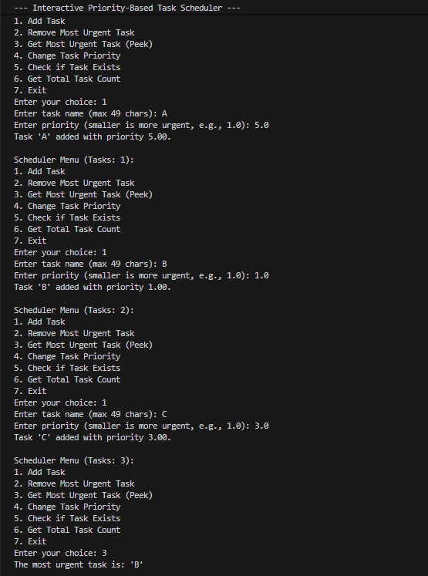
Scenario 1:

Slide 12
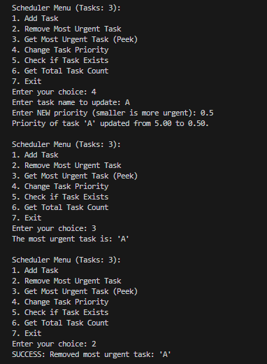
Scenario 2:

Slide 13
Conclusion
and Division of Work
Efficiency Achieved: We successfully implemented a Priority Queue using a Min-Heap, achieving the required O(1) retrieval time for the most urgent task.
Functionality: All specified operations were implemented and proven correct through the interactive command-line interface

Slide 14
Conclusion
and Division of Work
Implemented Functionalities:
Shubhika Pradeep: int size() and void changePriority().
Vansh Sharma: getSmallest() and removeSmallest().
V. Tanisha Reddy: bool contains() and void add().

Slide 15
Thank
You!

